Slide 1
Angular 11

Slide 2
1.1 About Angular
Angular is one of the most powerful and performance-efficient JavaScript frameworks to build single-page applications for both web and mobile. The powerful features of Angular allow us to create complex, customizable, modern, responsive, and user-friendly web applications.
Angular follows a component-oriented application design pattern to develop completely reusable and modularized web applications.
Popular web platforms like Google Adwords, Google Fiber, Adsense have built their user interfaces using Angular.

Slide 3
1.2 Why Angular
Cross-Browser Compliant
Internet has evolved significantly from the time Angular 1.x was designed. Creating a web application that is cross-browser compliant was difficult with Angular 1.x framework. Developers had to come up with various workarounds to overcome the issues. Angular helps to create cross-browser compliant applications easily.
Typescript Support
Angular is written in Typescript and allows the user to build applications using Typescript. Typescript is a superset of JavaScript and more powerful language. The use of Typescript in application development improves productivity significantly.
Web Components Support
Component-based development is pretty much the future of web development. Angular is focused on component-based development. The use of components helps in creating loosely coupled units of application that can be developed, maintained, and tested easily.
Better support for Mobile App Development
Desktop and mobile applications have separate concerns and addressing these concerns using a single framework becomes a challenge. Angular 1 had to address the concerns of a mobile application using additional plugins. However, the Angular framework, addresses the concerns of both mobile as well as desktop applications.
Better performance
The Angular framework is better in its performance in terms of browser rendering, animation, and accessibility across all the components. This is due to the modern approach of handling issues compared to earlier Angular version 1.x.

Slide 4
1.2 Why Angular
Better support for Mobile App Development
Desktop and mobile applications have separate concerns and addressing these concerns using a single framework becomes a challenge. Angular 1 had to address the concerns of a mobile application using additional plugins. However, the Angular framework, addresses the concerns of both mobile as well as desktop applications.
Better performance
The Angular framework is better in its performance in terms of browser rendering, animation, and accessibility across all the components. This is due to the modern approach of handling issues compared to earlier Angular version 1.x.

Slide 5
1.3 SPA
A Single Page Application (SPA) is a web application that interacts with the user by dynamically redrawing any part of the UI without requesting an entire new page from the server.
For example, have a look at the Amazon web application. When you click on the various links present in the navbar present in any of the web pages of this application, the whole page gets refreshed. This is because visibly, a new request is sent for the new page for almost each user click. You may hence observe that it is not a SPA.
But, if you look at the Gmail web application, you will observe that all user interactions are being handled without completely refreshing the page.
Modern web applications are generally SPAs. SPAs provide a good user experience by communicating asynchronously (a preferable way of communication) with a remote web server (generally using HTTP protocol) to dynamically check the user inputs or interactions and give constant feedback to the user in case of any errors, or wrongful/invalid user interaction. They are built block-by-block making all the functionalities independent of each other. All desktop apps are SPAs in the sense that only the required area gets changed based on user requests.
Angular helps to create SPAs that will dynamically load contents in a single HTML file, giving the user an illusion that the application is just a single page.

Slide 6
1.4 TypeScript
Developers prefer TypeScript to write Angular code. But other than TypeScript, you can also write code using JavaScript (ES5 or ECMAScript 5).
Why most developers prefer TypeScript for Angular?
TypeScript is Microsoft’s extension for JavaScript which supports object-oriented features and has a strong typing system that enhances productivity.
TypeScript supports many features like annotations, decorators, generics, etc.
A very good number of IDE’s like Sublime Text, Visual Studio Code, Nodeclipse, etc., are available with TypeScript support.
TypeScript code is compiled to JavaScript code using build tools like npm, bower, gulp, webpack, etc., to make the browser understand the code.

Slide 7
1.5 Features of Angular
Easier to learn: Angular is more modern and easier for developers to learn. It is a more streamlined framework where developers will be focusing on writing JavaScript classes.
Good IDE support: Angular is written in TypeScript which is a superset of JavaScript and supports all ECMAScript 6 features. Many IDEs like Eclipse, Microsoft Visual Studio, Sublime Text, etc., have good support for TypeScript.
Familiar: Angular has retained many of its core concepts from the earlier version (Angular 1), though it is a complete re-write. This means developers who are already proficient in Angular 1 will find it easy to migrate to Angular.
Cross-Platform: Angular is a single platform that can be used to develop applications for multiple devices.
Performance: Angular performance has been improved a lot in the latest version. This has been done by automatically adding or removing reflect metadata from the polyfills.ts file which makes the application smaller in production.
Lean and Fast: Angular application's production bundle size is reduced by 100s of kilobytes due to which it loads faster during execution.
Bundle Budgets: Angular will take advantage of the bundle budgets feature in CLI which will warn if the application size exceeds 2MB and will give errors if it exceeds 5MB. Developers can change this in angular.json.
Simplicity: Angular 1 had 70+ directives like ng-if, ng-model, etc., whereas Angular has a very less number of directives as you use [ ] and ( ) for bindings in HTML elements.

Slide 8
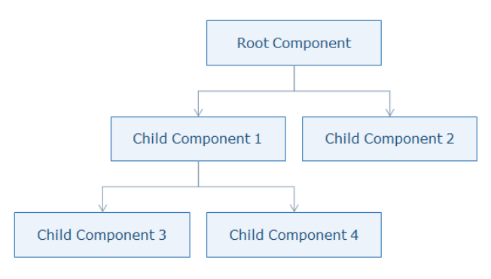
1.6 Component based
Angular follows component-based programming which is the future of web development. Each component created is isolated from every other part of our application. This kind of programming allows us to use components written using other frameworks.
Inside a component, you can write both business logic and view.
Every Angular application must have one top-level component referred to as 'Root Component' and several sub-components or child components.

Slide 9

2. Setup
To develop an application using Angular on a local system, you need to set up a development environment that includes the installation of:
Node.js (12.14.1 || >=14.0.0) and npm (min version required 6.13.4)
Angular CLI
Visual Studio Code
Install Node.js and Visual Studio Code from their respective official websites.
Install Angular CLI Check Version
Angular CLI is a command-line interface tool to build Angular applications. It makes application development faster and easier to maintain.
Using CLI, you can create projects, add files to them, and perform development tasks such as testing, bundling, and deployment of applications.

Slide 10
2. Setup
Command | Purpose
npm install -g @angular/cli | Installs Angular CLI globally
ng new <project name> | Creates a new Angular application
ng serve --open | Builds and runs the application on lite-server and launches a browser
ng generate <name> | Creates class, component, directive, interface, module, pipe, and service
ng build | Builds the application
ng update @angular/cli @angular/core | Updates Angular to a newer version

Slide 11

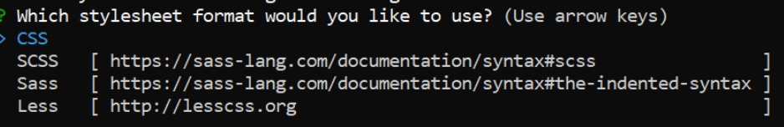
2. Setup
Demo steps:
1. Create an application with the name 'MyApp' using the following CLI command
2. The above command will display two questions. The first question is as shown below. Typing 'y' will create a routing module file (app-routing.module.ts).
3. The next question is to select the stylesheet to use in the application. Select CSS.

Slide 12

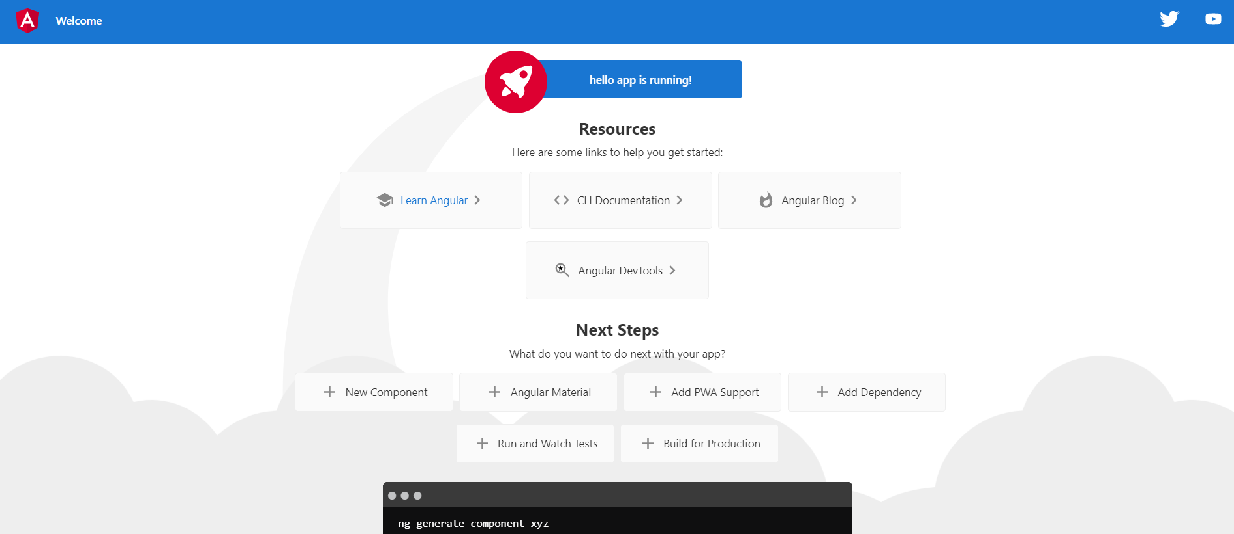
2. Setup
4. Run angular application
ng serve will build and run the application
--open option will show the output by opening a browser automatically with the default port.
Use the following command to change the port number if another application is running on the default port(4200)
Output:
http://localhost:4200/

Slide 13
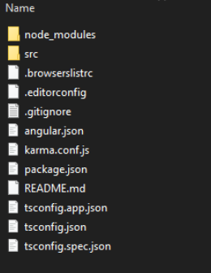
2. Setup
File / Folder | Purpose
node_modules/ | Node.js creates this folder and puts all npm modules installed as listed in package.json
src/ | All application-related files will be stored inside it
angular.json | Configuration file for Angular CLI where we set several defaults and also configure what files to be included during project build
package.json | This is a node configuration file that contains all dependencies required for Angular
tsconfig.json | This is the Typescript configuration file where we can configure compiler options
tslint.json | This file contains linting rules preferred by the Angular style guide
Folder structure:

Slide 14
3. Create component and module
Why Components in Angular?
A component is the basic building block of an Angular application
It emphasize the separation of concerns and each part of the Angular application can be written independently of one another
It is reusable
Observe for our AppComponent you have below files
app.component.ts
app.component.html
app.component.css
app.component.spec.ts

Slide 15
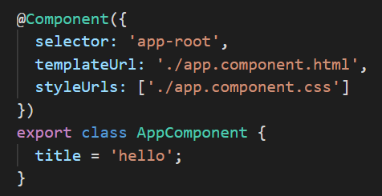
@Component: Adds component decorator to the class which makes the class a component
selector: Specifies the tag name to be used in the HTML page to load the component
templateURL: Specifies the template or HTML file to be rendered when the component is loaded in the HTML page. The template represents the view to be displayed
styleUrls: Specifies the stylesheet file which contains CSS styles to be applied to the template.
export: Every component is a class (AppComponent, here) and export is used to make it accessible in other components
app.component.ts

Slide 16
3. Create component and module
Best Practices - Coding Style Rules
Always write one component per file. This will make it easier to read, maintain, and avoid hidden bugs. It makes code reusable and less mistake-prone.
Always define small functions which makes it easier to read and maintain
The recommended pattern for file naming convention is feature.type.ts. For example, to create a component for Login, the recommended filename is login.component.ts. Use the upper camel case for class names. For example, LoginComponent.
Use a dashed case for the selectors of a component to keep the names consistent for all custom elements. Ex: app-root

Slide 17
3. Create component and module
Best Practices - Coding Style Rules
Always write one component per file. This will make it easier to read, maintain, and avoid hidden bugs. It makes code reusable and less mistake-prone.
Always define small functions which makes it easier to read and maintain
The recommended pattern for file naming convention is feature.type.ts. For example, to create a component for Login, the recommended filename is login.component.ts. Use the upper camel case for class names. For example, LoginComponent.
Use a dashed case for the selectors of a component to keep the names consistent for all custom elements. Ex: app-root

Slide 18
3.2 Modules
Modules in Angular are used to organize the application.
It sets the execution context of an Angular application.
A module in Angular is a class with the @NgModule decorator added to it. @NgModule metadata will contain the declarations of components, pipes, directives, services that are to be used across the application.
Every Angular application should have one root module which is loaded first to launch the application.
Submodules should be configured in the root module.

Slide 19
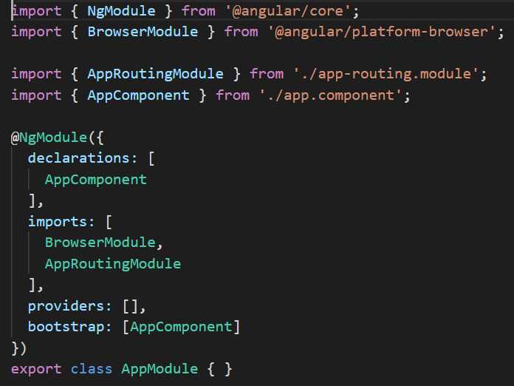
imports BrowserModule class which is needed to run the application inside the browser
imports NgModule class to define metadata of the module
imports AppComponent class from app.component.ts file. No need to mention the .ts extension as Angular by default considers the file as a .ts file
declarations property should contain all user-defined components, directives, pipes classes to be used across the application. We have added our AppComponent class here
imports property should contain all module classes to be used across the application
app.module.ts

Slide 20
providers' property should contain all service classes. You will learn about the services later in this course
bootstrap declaration should contain the root component to load. In this example, AppComponent is the root component that will be loaded in the HTML page
app.module.ts

Slide 21
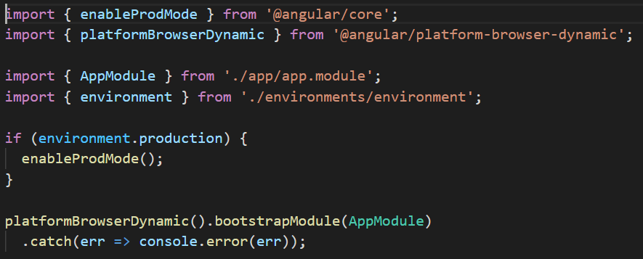
Line 1: imports enableProdMode from the core module
Line 2: import platformBrowserDynamic class which is used to compile the application based on the browser platform
Line 4: import AppModule which is the root module to bootstrap
Line 5: imports environment which is used to check whether the type of environment is production or development
Line 7: checks if you are working in a production environment or not
Line 8: enableProdMode() will enable production mode which will run the application faster
Line 11: bootstrapModule() method accepts root module name as a parameter which will load the given module i.e., AppModule after compilation
Main.ts

Slide 22
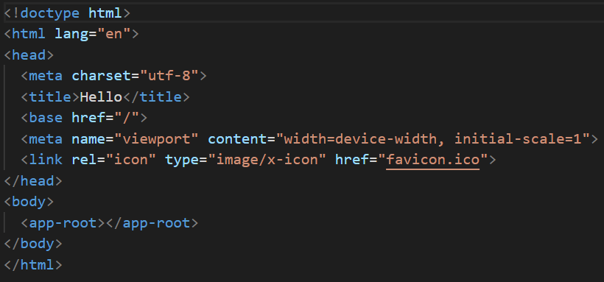
<app-root> loads the root component in the HTML page.
app-root is the selector name given to the component. This will execute the component and renders the template inside the browser.
Index.html

Slide 23
3.2 Module
Best Practices - Coding Style Rules
Always add a Module keyword to the end of the module class name which provides a consistent way to quickly identify the modules. Ex: AppModule.
Filename convention for modules should end with module.ts
Always name the module with the feature name and the folder it resides in which provides a way to easily identify it.

Slide 24

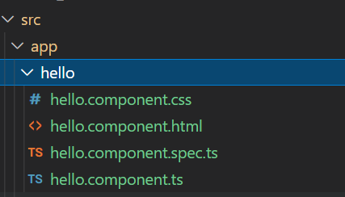
3.3 Creating a component
Create a new component called hello using the following CLI command
This command will create a new folder with the name hello with the following files placed inside it
Check app.module.ts , component will be added in declarations
Change in index.html, add component selector instead of root component selector, change in bootstrap in app.module.ts

Slide 25
3.4 Templates
Introduction to Templates
Templates separate the view layer from the rest of the framework.
You can change the view layer without breaking the application.
Templates in Angular represents a view and its role is to display data and change the data whenever an event occurs
The default language for templates is HTML
Creating a template
Template can be defined in two ways:
Inline Template
External Template

Slide 26
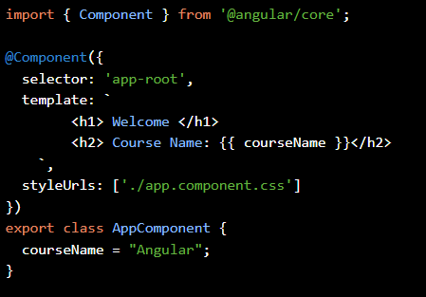

3.4 Templates
Inline Template:
Use backtick character ` for multi-line strings

Slide 27

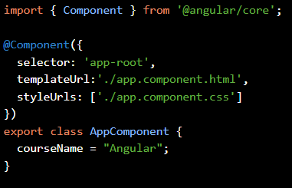
3.4 Templates
External Template:
app.component.html
templateUrl property is used to bind an external template file with the component
app.component.ts

Slide 28
3.4 Elements of Templates
Introduction to Templates
Templates separate the view layer from the rest of the framework.
You can change the view layer without breaking the application.
Templates in Angular represents a view and its role is to display data and change the data whenever an event occurs
The default language for templates is HTML
Creating a template
Template can be defined in two ways:
Inline Template
External Template

Slide 29

3.4 Elements of Templates
basic elements of template syntax:
HTML
Interpolation
Template Expressions
Template Statements
HTML
Angular uses HTML as a template language. In the below example, the template contains pure HTML code.
Interpolation
Interpolation is one of the forms of data binding where component’s data can be accessed in a template. For interpolation, double curly braces {{ }} is used.
Template Expressions
The text inside {{ }} is called as template expression.

Slide 30

3.4 Elements of Templates
Template Expressions
The text inside {{ }} is called as template expression.
Angular first evaluates the expression and returns the result as a string. The scope of a template expression is a component instance.
That means, if you write {{ courseName }}, courseName should be the property of the component to which this template is bound.
Template Statement
Template Statements are the statements that respond to a user event.

Slide 31
3.4 Elements of Templates
Change Detection
What is the change detection mechanism, and how it helps to run Angular applications so faster?
Change Detection is a process in Angular that keeps views in sync with the models.
In Angular, the flow is unidirectional from top to bottom in a component tree. A change in a web application can be caused by events, Ajax calls, and timers which are all asynchronous.
Who informs Angular about the changes?
Zones inform Angular about the changes in the application. It automatically detects all asynchronous actions at run time in the application.

Slide 32
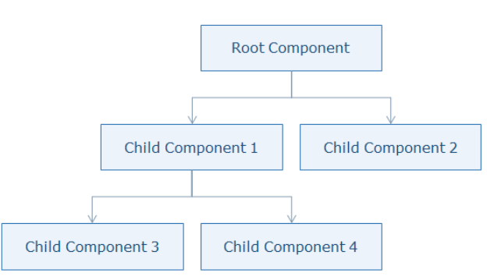
3.4 Elements of Templates
Angular runs a change detector algorithm on each component from top to bottom in the component tree. This change detector algorithm is automatically generated at run time which will check and update the changes at appropriate places in the component tree.
Angular is very fast though it goes through all components from top to bottom for every single event as it generates VM-friendly code. Due to this, Angular can perform hundreds of thousands of checks in a few milliseconds.

